Slide 1

GROUP 13
Deciphering Road Accidents: Predictive Analytics for Road Accident Severity
Staying ahead of road accidents

Slide 2
Group Members
Esther Gakio
Andrew Maina
Lynns Waswa
Anita Bosibori
Chris Mukiri
Let’s dive

Slide 3

Problem Statement
Road accidents are a major concern worldwide, causing injuries and deaths that have a profound impact on families and communities.
According to the World Health Organization (WHO), road traffic injuries are among the top 10 leading causes of death worldwide, highlighting the urgent need for effective prevention strategies.
By studying the reasons behind these accidents, we can develop targeted interventions to improve road safety and reduce the number of accidents, injuries, and fatalities on roads

Slide 4

Objectives
Identify Key Predictive Factors: Analyze various factors including roadway conditions, environmental influences, and driver behavior to identify the most significant predictors of crash occurrences.
Build a Predictive Model for Crash Severity: Construct and train a predictive model to accurately forecast the severity of road accidents, categorizing outcomes as non-injury, minor, serious, or fatal.
Develop an Early Warning System: Create a system that uses the predictive model to identify high-risk areas and times for potential accidents.
Optimize Resource Allocation with Predictive Analytics: Utilize the predictive model to improve the allocation of emergency response and medical resources.

Slide 5

Data Understanding
Source of Data: The dataset utilized for this analysis was obtained from the official New Zealand Government data website. It encompasses comprehensive information regarding road accidents spanning from the year 2000 through April 2024.

Slide 6

Data visualizations
We looked at the following visualizations:
Spread of speed limit by crash severity
Count of fatal road accidents in different weather conditions
Chart of fatal road accidents in different road terrain
Model performance

Slide 7
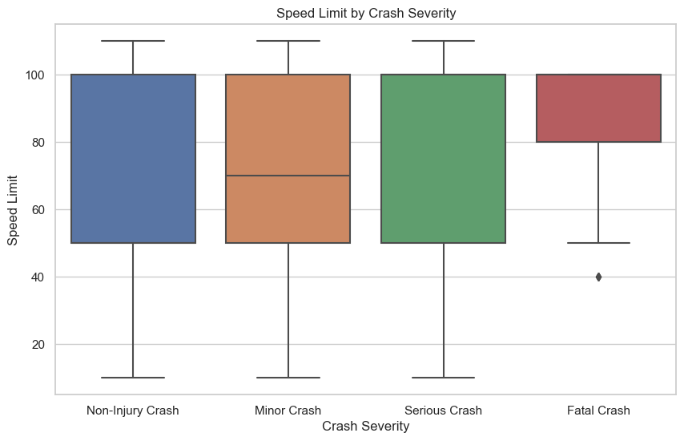
Spread of speed limit by crash severity
Most fatal crashes occur when the speed limit is between 80 and 100 kph

Slide 8
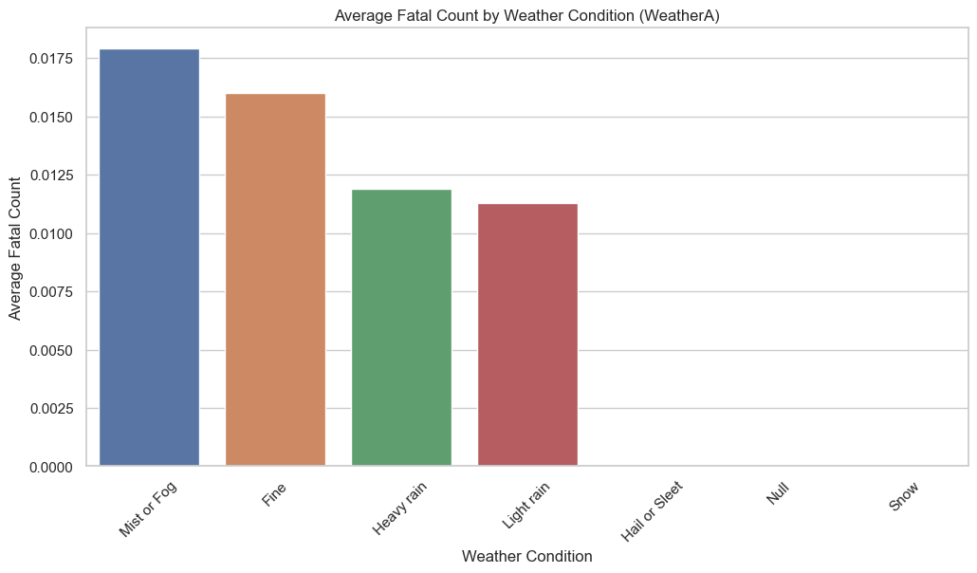
Count of fatal road accidents in different weather conditions
Most fatal road accidents occur when there is mist or fog

Slide 9
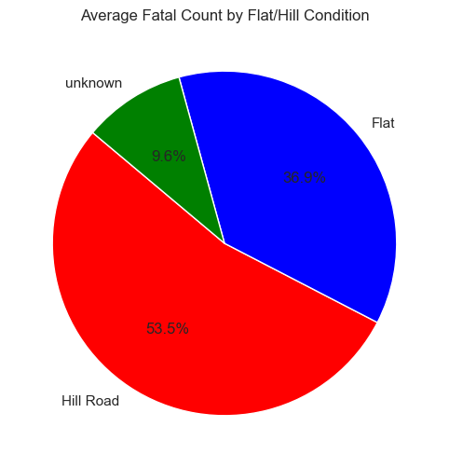
Chart of fatal road accidents in different road terrain
Most fatal road accidents occur on hilly roads

Slide 10
Most important features that determine road accident severity
Street Light - Whether streetlights are on, off, or unavailable
Pedestrian - Whether pedestrians are involved
Speed Limit - The speed limit on the road
Vehicles involved - The type of vehicles involved
Light - Whether it is dark, bright, twilight or overcast
Holiday - The holiday celebrated on a specific day
Flat/Hill - Whether the road is flat or hilly
obstacles hit - Number of obstacles on the road
weather - The weather conditions
Road surface - Whether the road is sealed or unsealed
Injury count - The number of injured people and
the severity

Slide 11
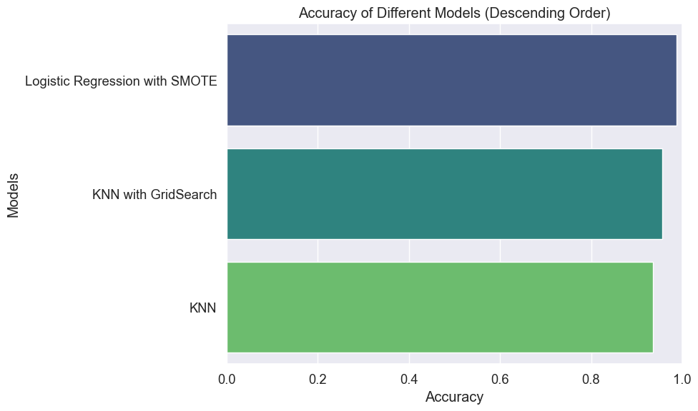
Model Performance
Logistic regression with SMOTE and KNN with gridsearch were the two best performing models

Slide 12
Conclusions
The models were able to predict how severe a road accident can be with an accuracy of up to 95.56%.
Factors such as holiday periods, inadequate lighting, pedestrian presence, road conditions, and the number of vehicles involved significantly influence the severity of crashes."
Critical risk factors that contribute to the frequency and intensity of accidents include hilly terrain, foggy weather, limited street lighting, and nighttime conditions.

Slide 13
Recommendations
Enhancing Road Safety During Mist and Foggy Conditions
Improve visibility during mist or fog, including reflective road signs and vehicle lighting.
Use advanced weather forecasting to provide real-time alerts.
Educate drivers on safe practices during foggy conditions.
Upgrade roadside infrastructure to alert drivers of fog conditions
Reducing the number of obstacles on the road
Reducing the number of buildings, trees, kerbs, posts and other obstacles on highway roads ensures more smooth rides for motorists, and should road accidents occur, they will be fewer fatal ones.

Slide 14
Recommendations
Data collection
More data from different countries all over the world need to do a more thorough documentation of road accidents occuring so as to have more sufficient data to build more accurate predictive models to assess severity of road accidents.
Safety campaigns
Implement targeted road safety campaigns focusing on the identified risk factors to raise awareness among road users and promote responsible driving practices in challenging terrain and low-light areas.

Slide 15
Questions ?

